Slide 1
Dynamic Property Price Prediction: A Predictive System for Smart Real-Estate Decision Deployment

Slide 2
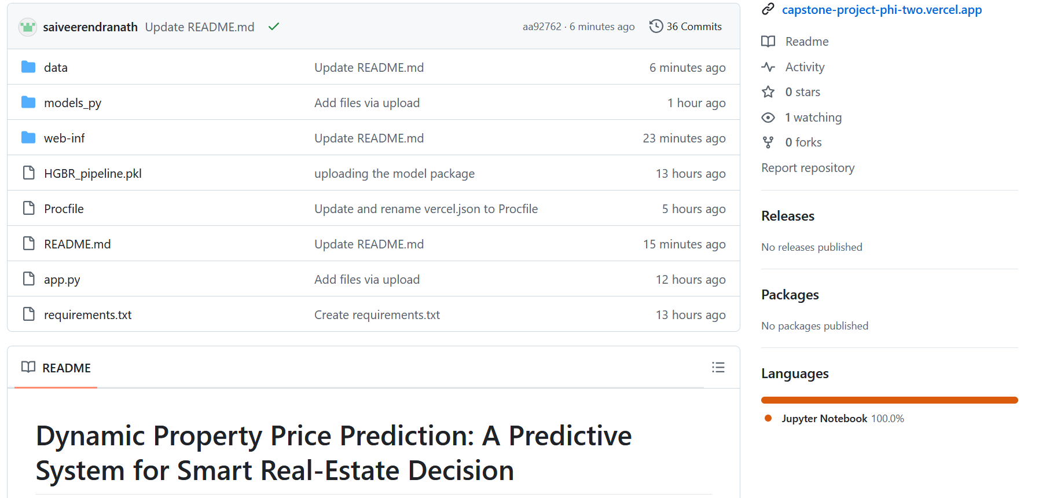

Slide 3
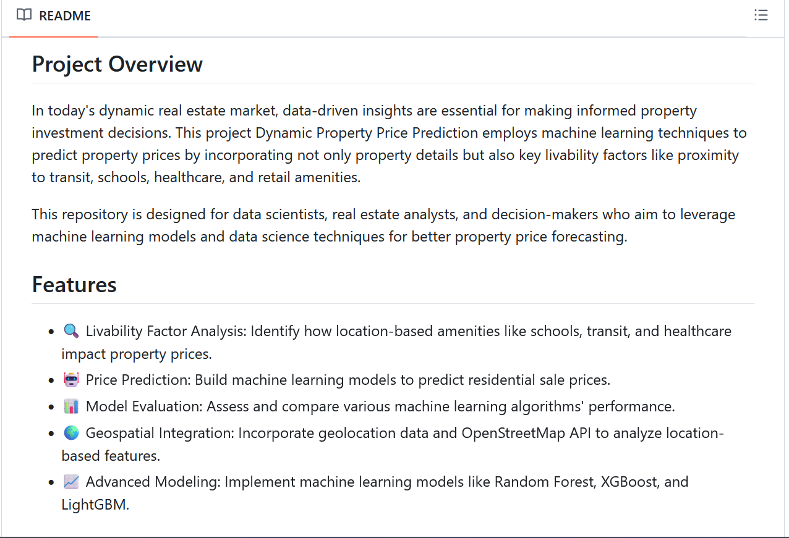

Slide 4
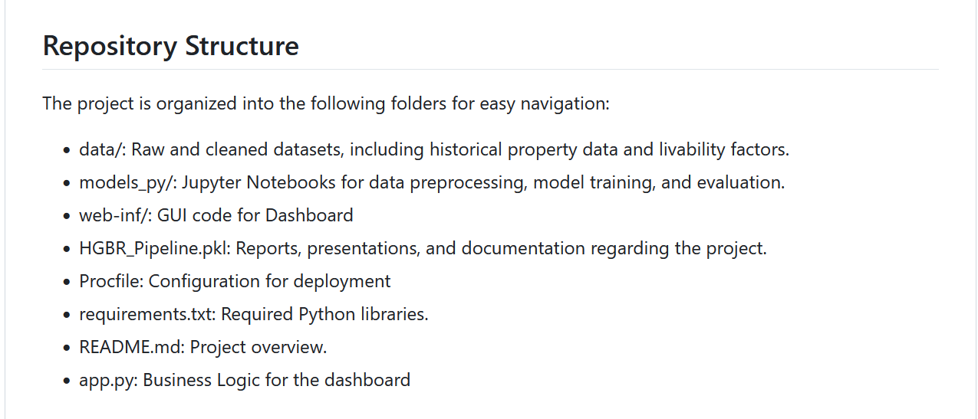

Slide 5
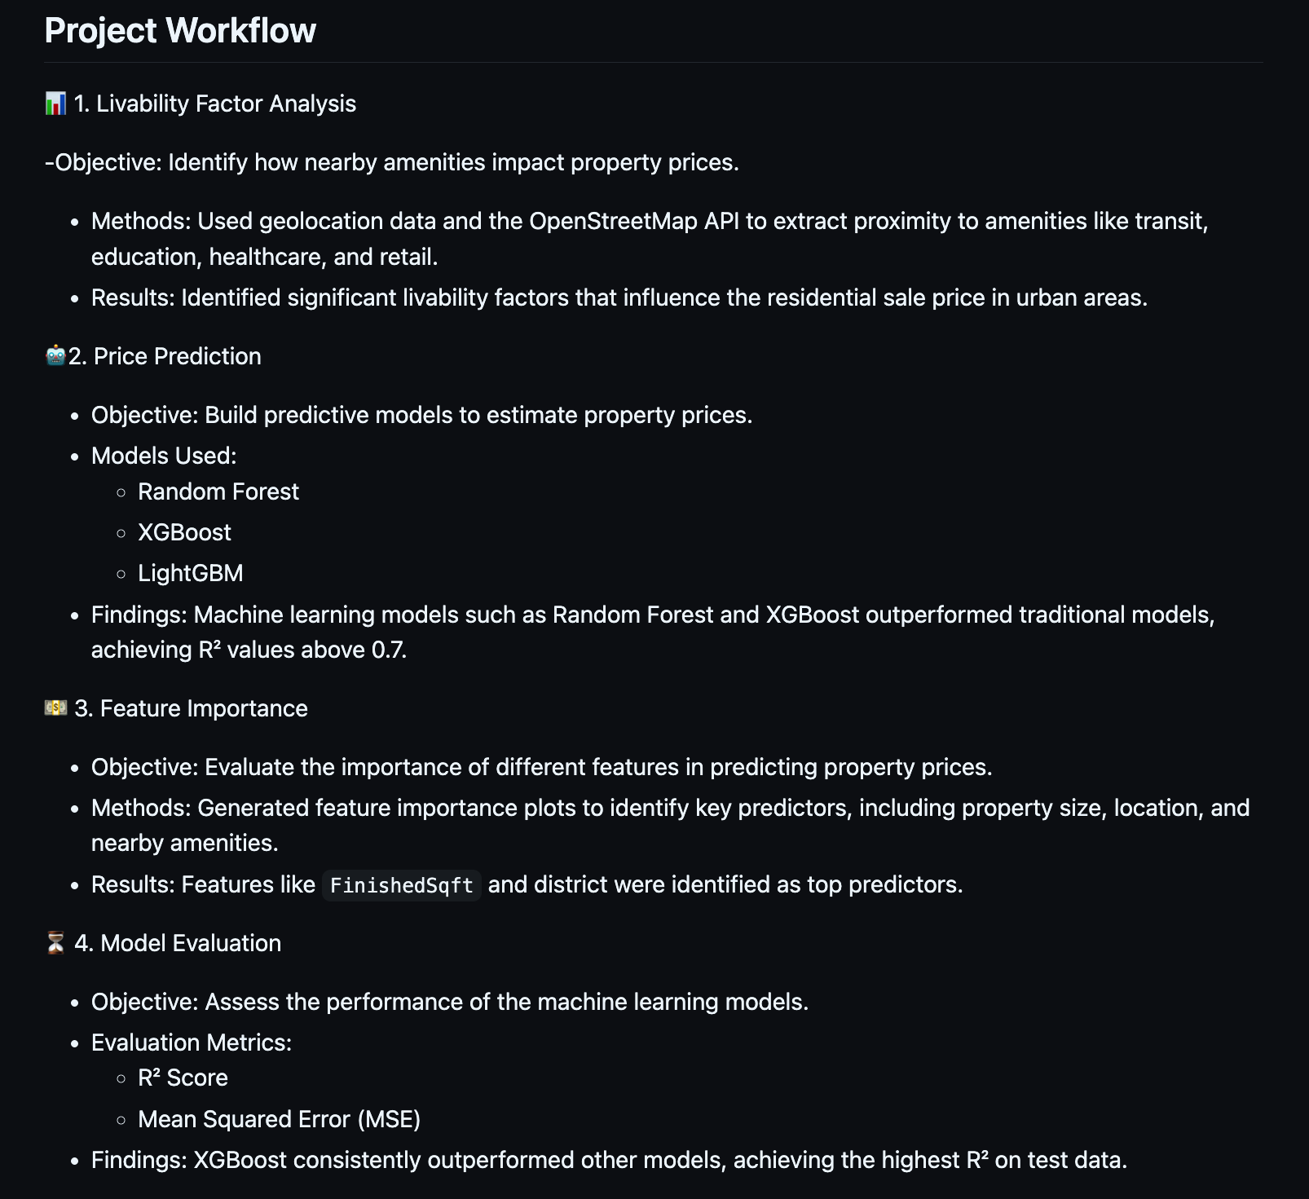

Slide 6
Deployment Scope
Scope of Deployment:
Web Application Integration: The model will be integrated into a web-based application to provide dynamic price predictions.
Scalability: Ensure that the deployment can handle multiple requests simultaneously, adjusting to the scale of real-world usage.
Real-Time Updates: The system will continuously update prices based on new data.

Slide 7
Deployment Goals
Seamless Integration:
Ensure smooth communication between the front-end dashboard and the back-end database, facilitating real-time price prediction.
Integration of external APIs for livability factors and event data.
Real-Time Predictions:
Real-time property price predictions based on user input and historical data.
User-Friendly Interface:
Design an intuitive dashboard that allows users to interact with the system effortlessly, such as inputting property details or exploring heatmaps.

Slide 8
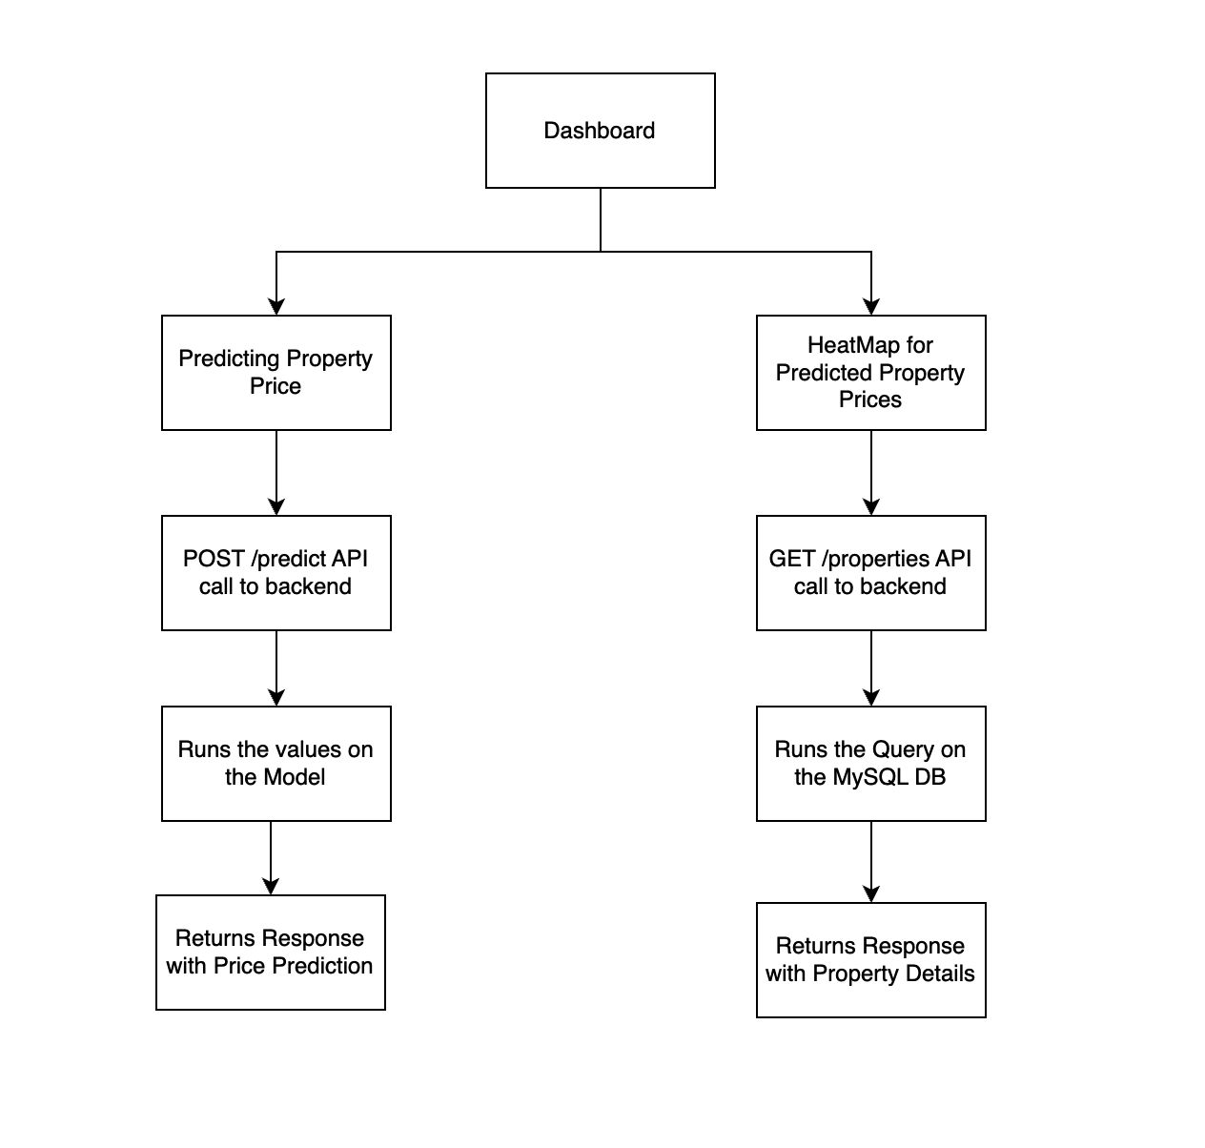
Flow of the Dashboard

Slide 9
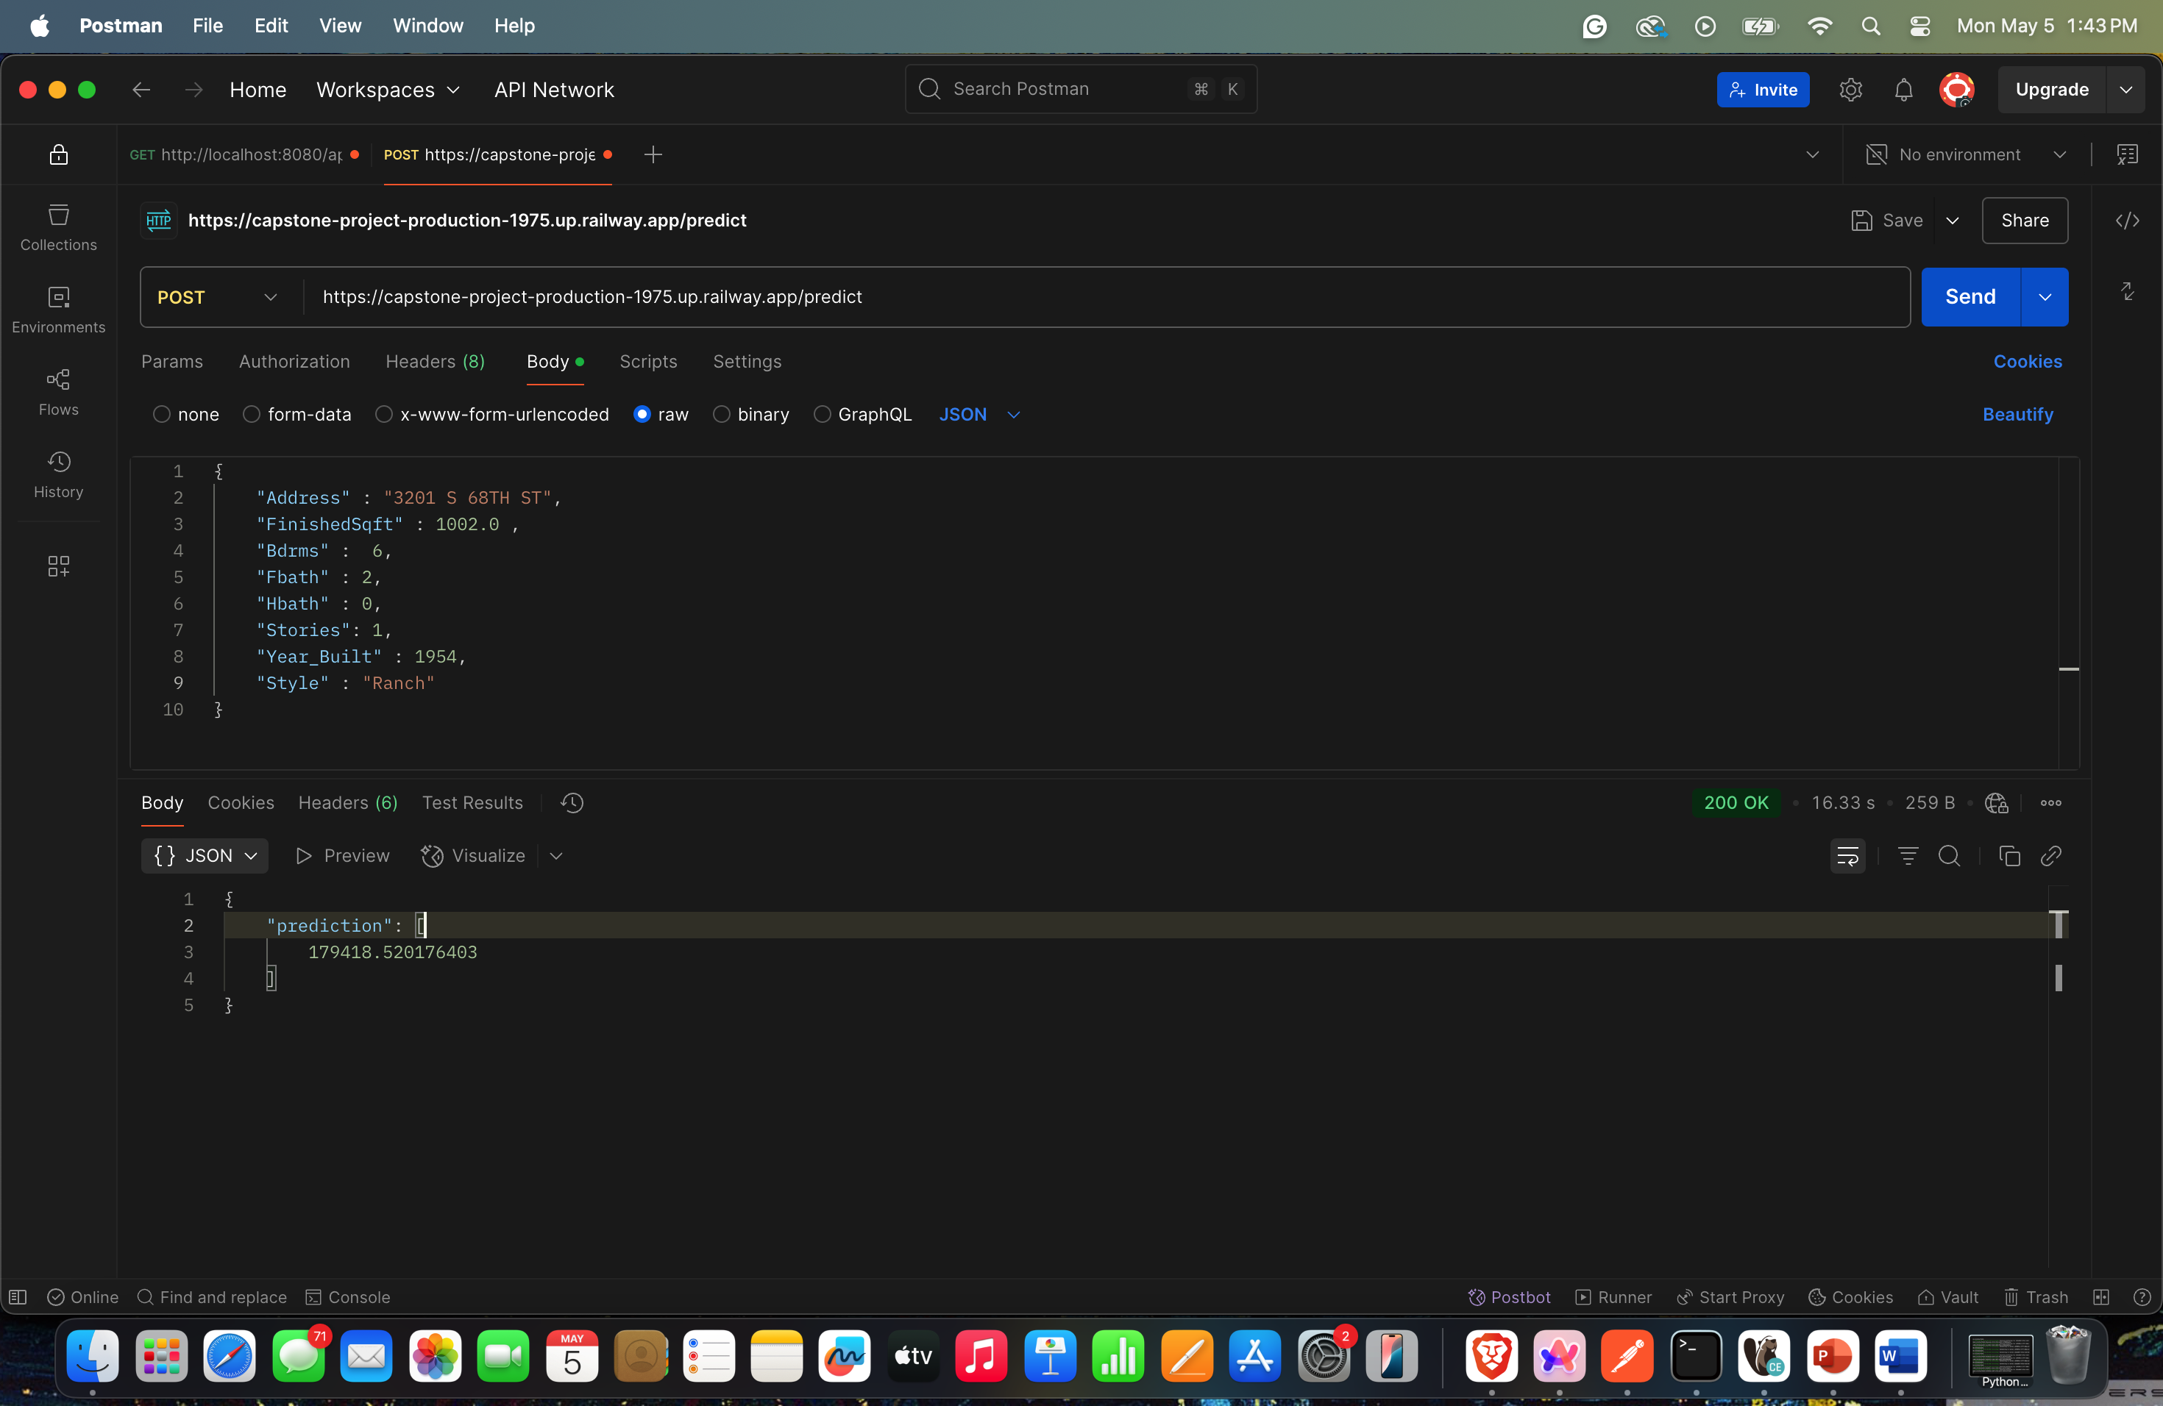
Back-End Deployment
For the back-end, we used FastAPI for communication between dashboard and MySQL Database.
Deployed the Git Repo with the back-end logic in the Railway App
Used ProcFile, requiements.txt for the deployment configurations.
Establising communication through a public URL and HTTP Protocol (GET/POST).

Slide 10
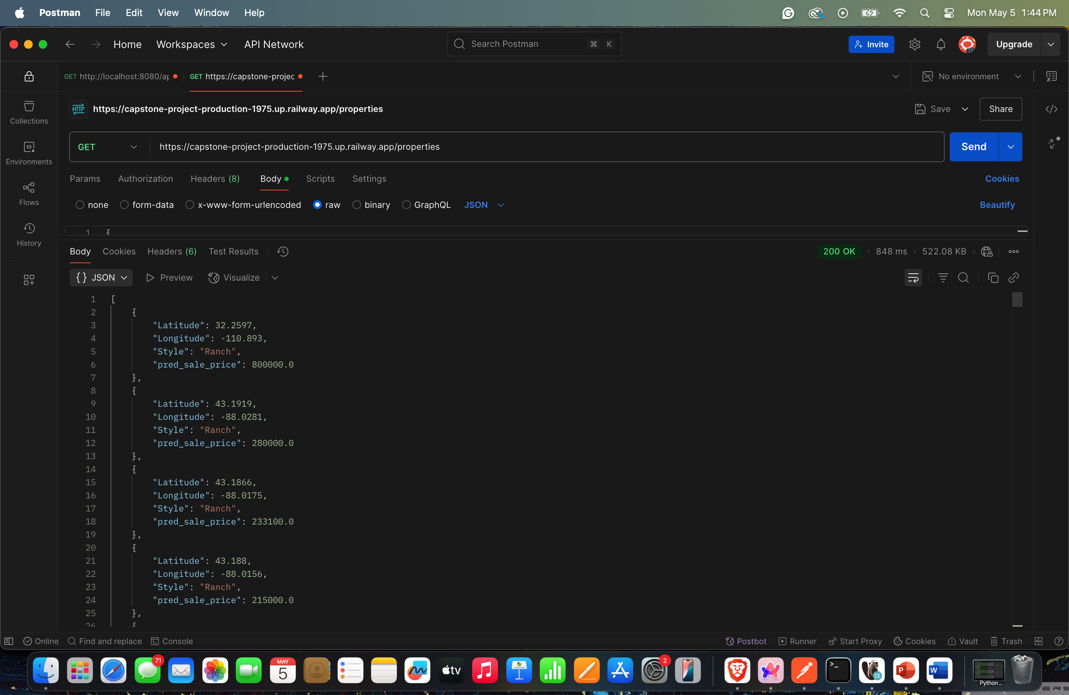
Back-End Deployment

Slide 11
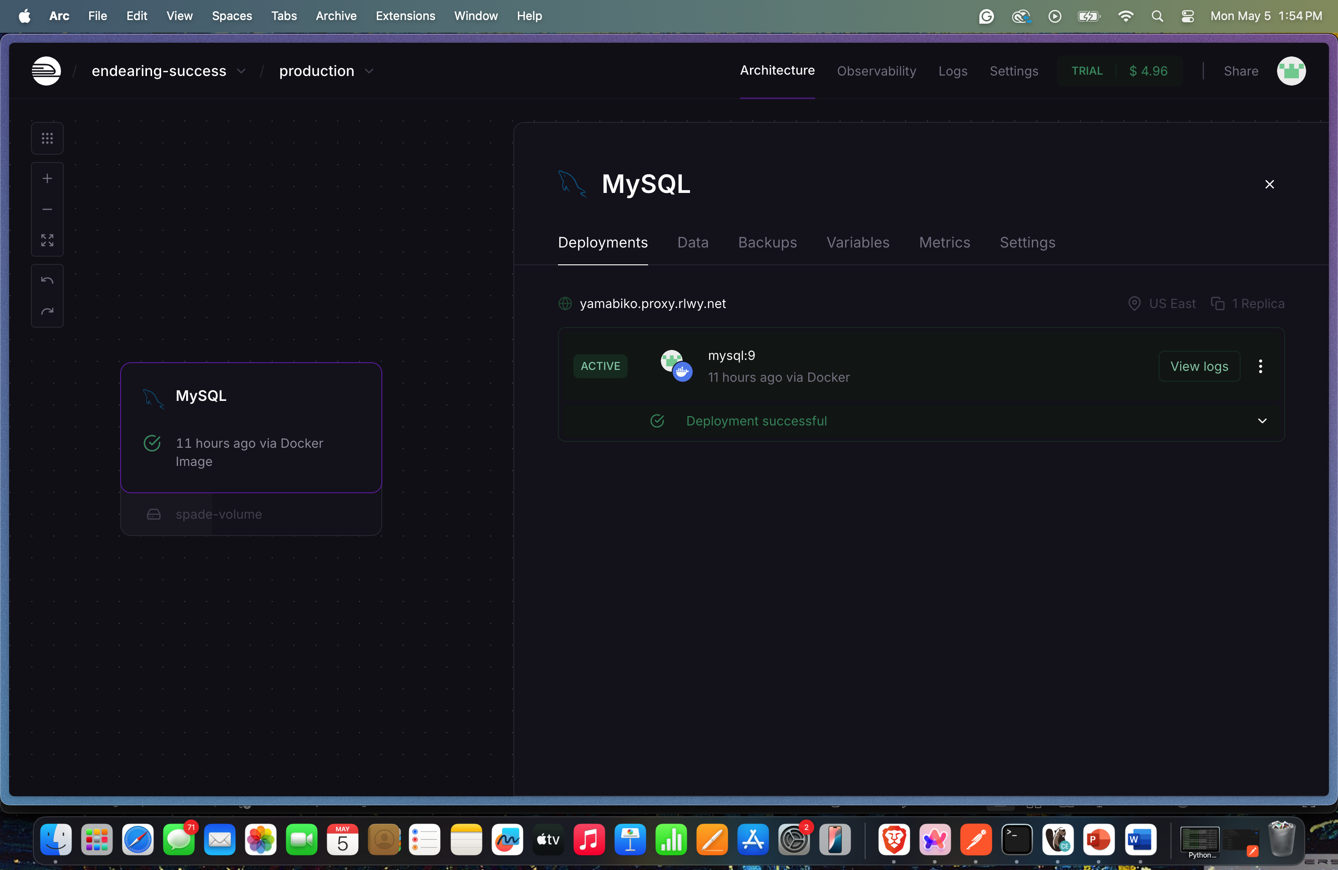
Database Deployment
We stored all the processed data from the model in a MySQL Database.
We used this data to display a heatmap in the dashboard.
Deployed the MySQL Database in the Railway App

Slide 12
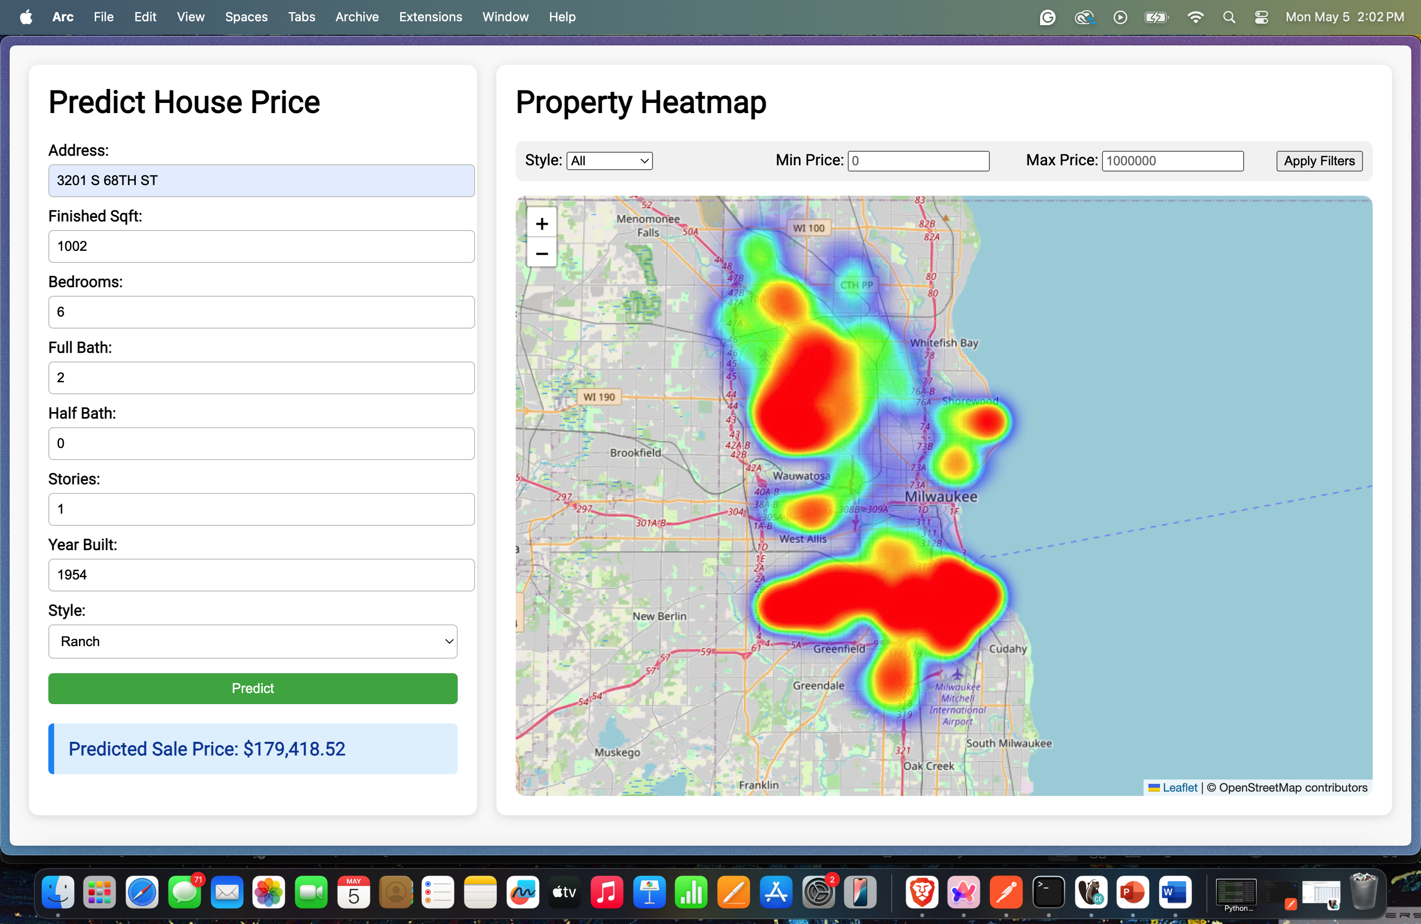
Front-End Deployment
Deployed the dashboard using GitHub - https://saiveerendranath.github.io/capstone-project/web-inf/dashboard.html.
We created two components – Predict House Price, Property Price HeatMap
Predict House Price takes the input values and computes the Livability Features in the back-end code on POST /predict API call.
Property Price HeatMap displays all the property prices from MySQL Database on GET /properties API Call.

Slide 13

Future Work: Enhancements & Next Steps
Enhancing Model Accuracy:
Incorporate additional external data sources like economic factors, zoning laws, and urban development plans to further enhance the model's predictive power.
User Interface Enhancements:
Improve the user interface with features such as interactive maps, filtering options, and better visualizations to help users interpret the data more easily.
AI/ML Model Improvements:
Explore the use of advanced AI/ML algorithms (e.g., deep learning, reinforcement learning) to adapt to changing market conditions and make more accurate long-term price predictions.

Slide 14
THANK YOU

